Slide 1


CMSE 381: Fundamentals of Data Science Methods
Jan 9th , 2023

Slide 2
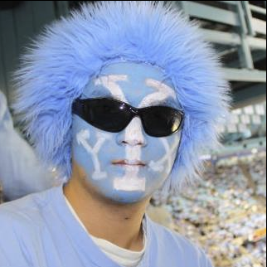
About me
谢於颖
YuYing Xie
Xie YuYing
XYY
Clark
Chr X Chr Y Y

Slide 3
About TA: Robert Termuhlen (termuhle@msu.edu)
Office Hours:

Slide 4
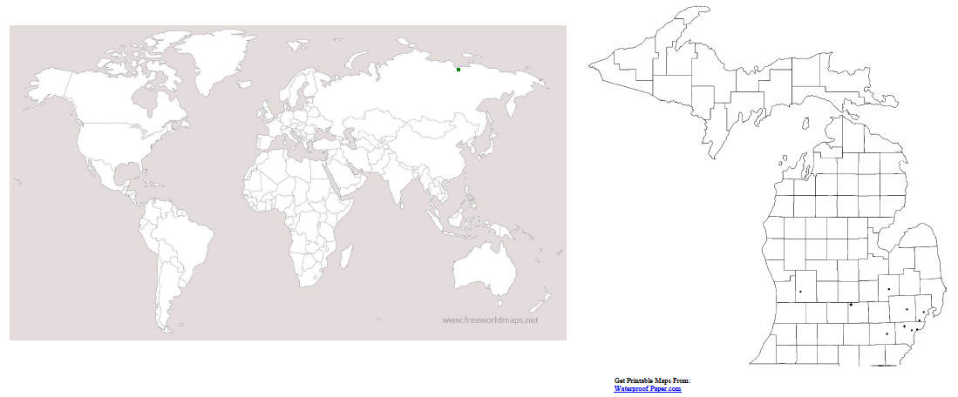
Introduce yourself. Annotate you

Slide 5
What is the course about?
Topics:
Fundamental concepts of data science
Regression
Classification
Dimension reduction
Resampling methods
Tree-based methods, etc.
Textbook:
An Introduction to Statistical Learning, with applications in R.
The Elements of Statistical Learning: Data Mining, Inference, and Prediction
Also have a youtube list

Slide 6
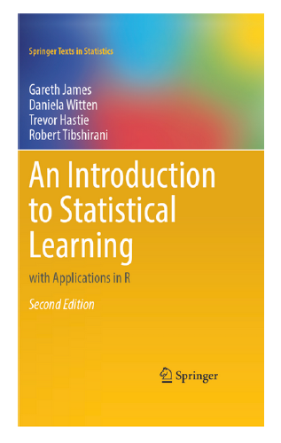
Textbook:
An Introduction to Statistical Learning, with applications in R.
Online version available!
https://www.youtube.com/user/joshstarmer

Slide 7
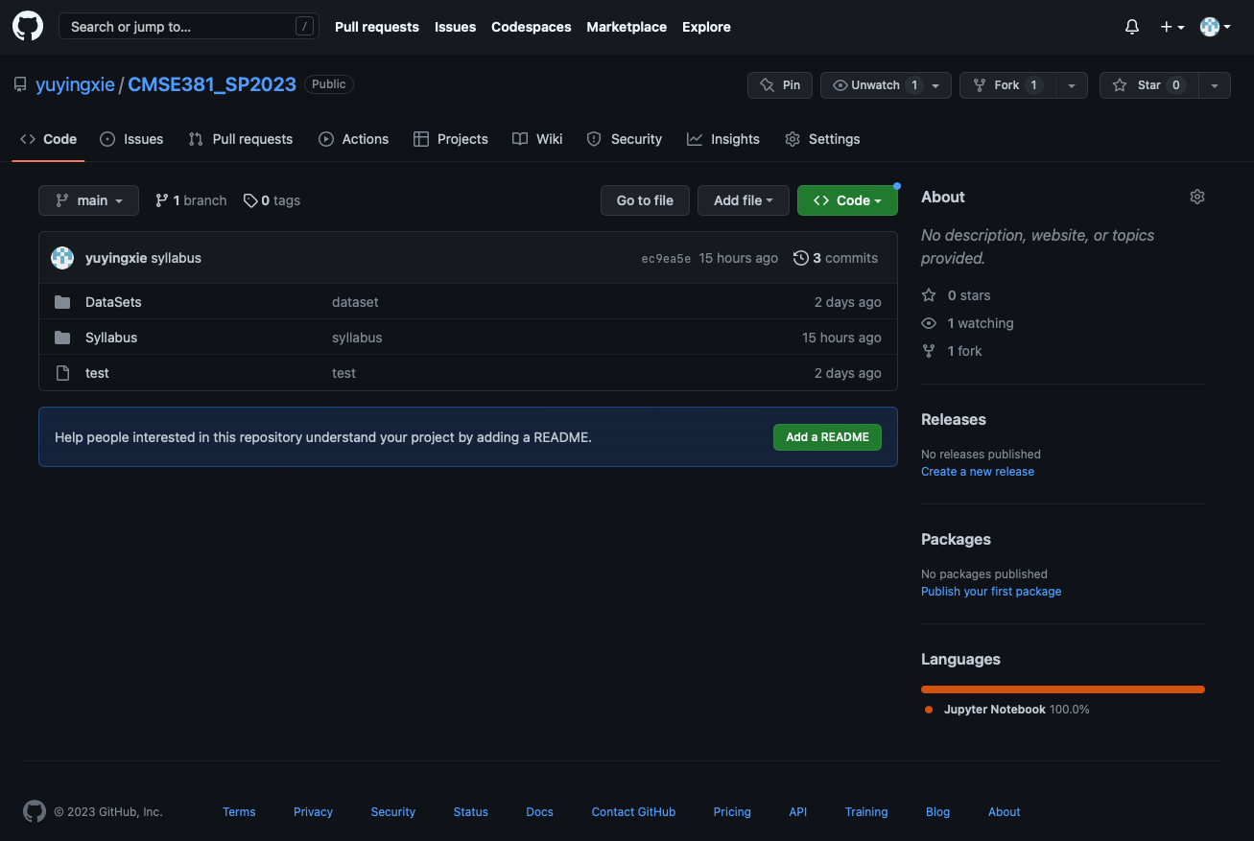
Github and where to find slides and jupyter notebooks
https://github.com/yuyingxie/CMSE381_SP2023

Slide 8
Office Hours
Zoom Link: shorturl.at/ghpNR
Dr. Xie
Time: Tues 12:00-1:30 pm
Zoom or Egr 1513
Bob Termuhlen
Time: TBA
Zoom or Egr 1513

Slide 9
Instruction Format
In Class:
Stop me if you have any question!
We will have coding section in most of the classes (bring your laptop)
What happens in CMSE 381 stays in CMSE 381
Grade Breakdown:
20% for Homework
15% for Quizzes
20% Midterm I
20% Midterm II
25% for the Final Project

Slide 10
Homework Policies
Homework assigned bi-weekly, it is due before midnight on Friday.
20% of final grade.
Late homework will have penalties (TA is full in charge. ).
24 hours late: 5% penalty
48 hours late: 15% penalty
> 48 hours: No late work accepted
Allowed to work with other students but homework should be in your own words.
Each homework carries equal weight.
Code needs to follow Google Style

Slide 11
Quiz Policies
Once a week, there will be a 10 minutes Quiz at the beginning of the class.
This will be basic content related to lectures since the last class. Possible questions include checking on definitions, or basic understanding of major ideas.
10 points per quiz
Drop two lowest grades
There will be some 3-minutes bonus-quizzes (1 credit) at the end of some classes. These credits can be added to your formal quizzes but your total Quiz-score is topped.

Slide 12
Graduate School 1. Research experience 2. Letters 3. Fellowship (NSF) 4. Course work 5. Broader Impact Industrial 1. Research experience 2. Internship 3. Programming skill (Leetcode) 4. Letters
Make yourself different!

Slide 13
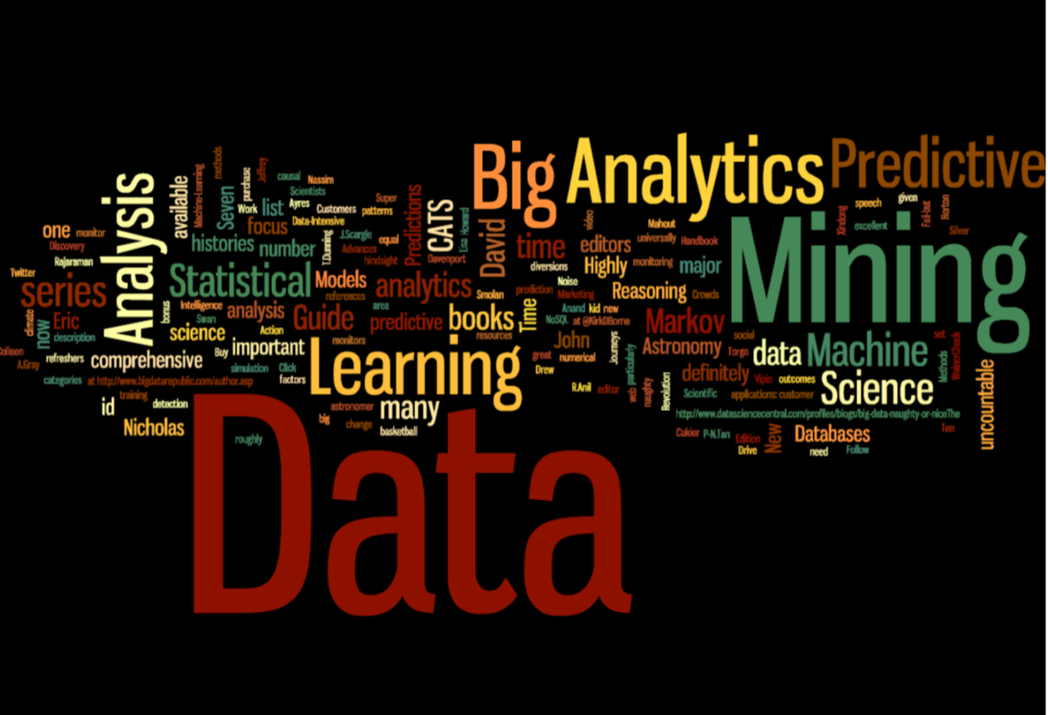
What is Machine Learning?
Arthur Samuel (1959, IBM): Field of study that gives computers the ability to learn without being explicitly programmed

Slide 14
What is Statistical Learning?
Subfield of Statistics
Statistical learning emphasizes models and their interpretability, and precision and uncertainty.
Machine learning has a greater emphasis on large scale applications and prediction accuracy.
The distinction between machine learning and statistical learning has become more and more blurred.

Slide 15
Why should you care?
Nowadays, data is cheap (or even free), learning how to analyze data is critical.
Web data, e-commerce (Amazon, JD, Alibaba)
Car sales (Tesla, Ford, and GM)
Sport team (MSU, Lions, etc)
Interpreting results and prevent any bad decisions.

Slide 16
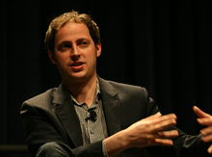
Example: Presidential election
http://fivethirtyeight.com/
On 2008, he correctly predicted the winner of 49 of the 50 states and all 35 U.S. Senate races .
On 2012, he correctly predicted the winner of all 50 states and the District of Columbia. That same year, Silver's predictions of U.S. Senate races were correct in 31 of 33 states.
All the data he used came from internet!
Dow down 313 points after Obama won
On 2016, oops…….

Slide 17
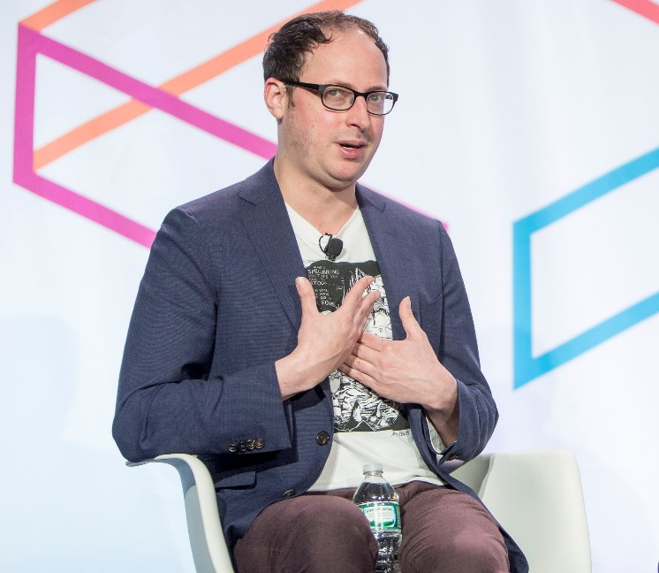
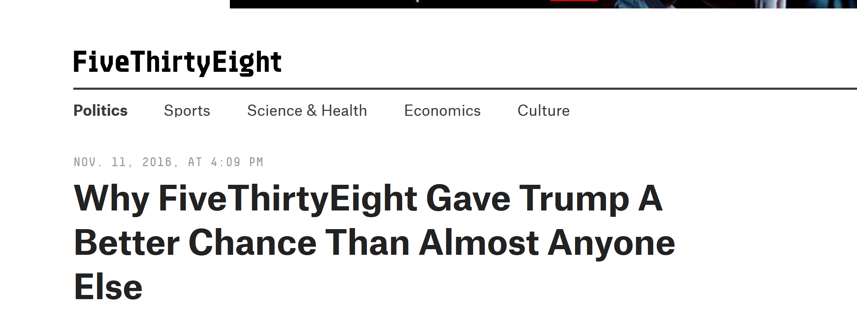
Example: Presidential election 2016

Slide 18
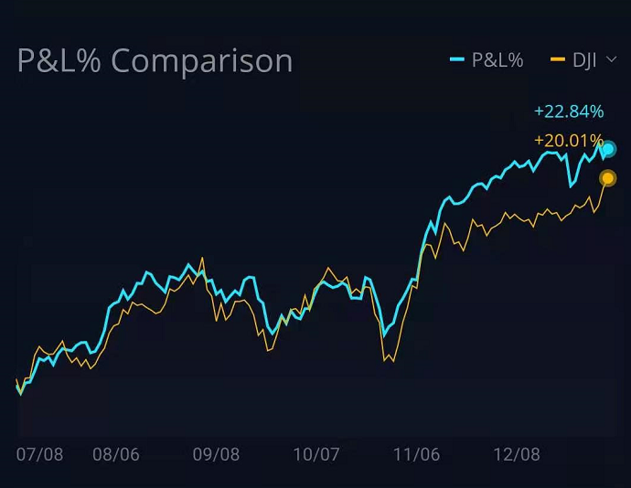
Example: Presidential election

Slide 19
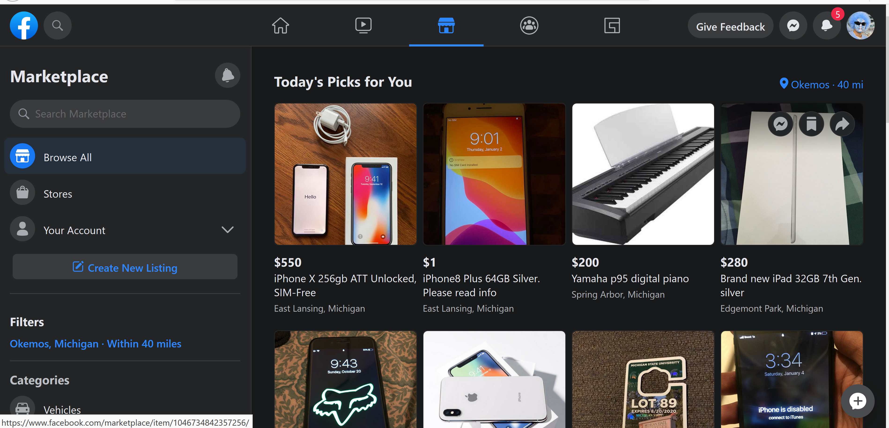
Example: Big Data

Slide 20
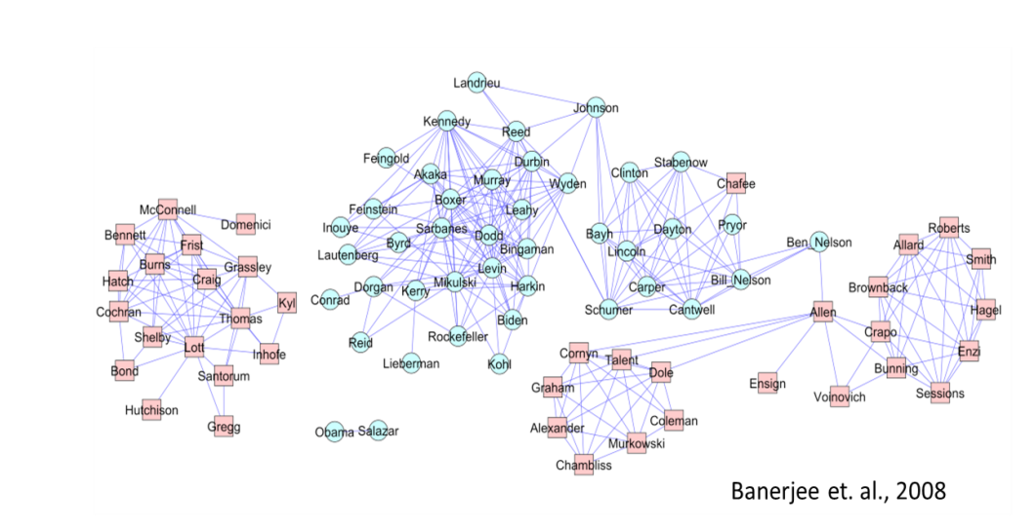
Politics

Slide 21
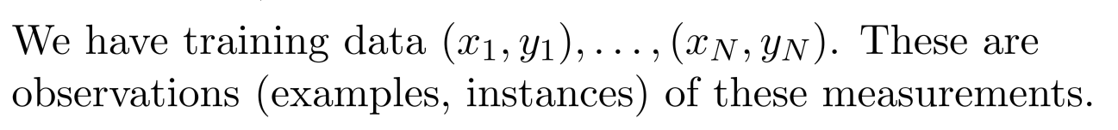
The Supervised Learning
Outcome measurement Y (also called dependent variable, response, target, label).
Vector of p predictor measurements X (also called inputs, regressors, covariates, features, independent variables).
In the regression problem, Y is quantitative (e.g price, blood pressure).
In the classiﬁcation problem, Y takes values in a ﬁnite, unordered set (survived/died, digit 0-9, cancer class of tissue sample).

Slide 22
Objectives
On the basis of the training data we want to?
Accurately predict unseen test cases.
Understand which inputs affect the outcome, and how.
Assess the quality of our predictions and inferences

Slide 23
Unsupervised Learning
No outcome variable, just a set of predictors (features) measured on a set of samples.
Objective is fuzzier: ﬁnd groups of samples that behave similarly, ﬁnd features that behave similarly, ﬁnd linear combinations of features with the most variation.
Diﬃcult to know how well you are are doing.
Diﬀerent from supervised learning but can be useful as a pre-processing step for supervised learning.

Slide 25

It obtains information related to customers via their mobile devices using 17 trillion location markers and various mobile applications that partner with SafeGraph.

Slide 26
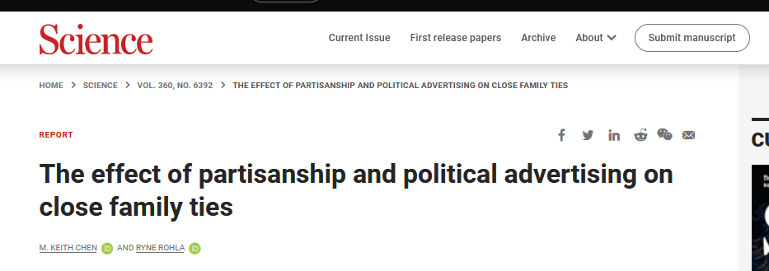
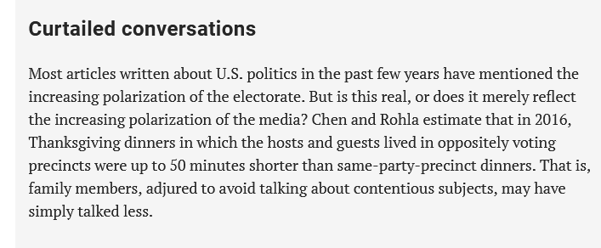

Slide 27
It obtains information related to customers via their mobile devices using 17 trillion location markers and various mobile applications that partner with SafeGraph.
How can you use this data?

Slide 28
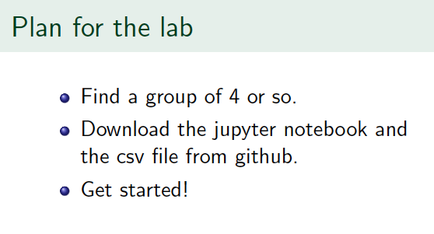

Slide 29
Question

